Slide 1





Slide 2
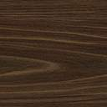

An anabolic, endergonic, carbon dioxide (CO₂) requiring process that uses light energy (photons) and water (H₂O) to produce organic macromolecules (glucose).
6CO₂ + 6H₂O → C₆H₁₂O₆ + 6O₂
SUN
photons
glucose

Slide 3
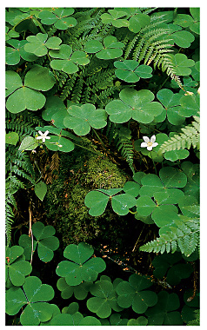
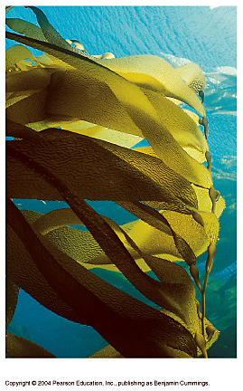
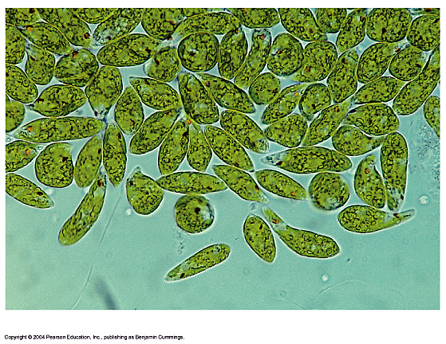
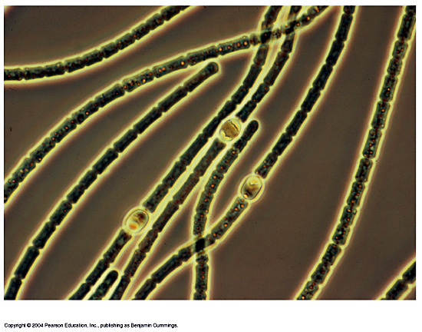
THE BASICS OF PHOTOSYNTHESIS
Almost all plants are photosynthetic autotrophs, as are some bacteria and protists
  Autotrophs generate their own organic matter through photosynthesis
  Sunlight energy is transformed to energy stored in the form of chemical bonds
(c) Euglena
(d) Cyanobacteria
(b) Kelp
(a) Mosses, ferns, and
flowering plants

Slide 4

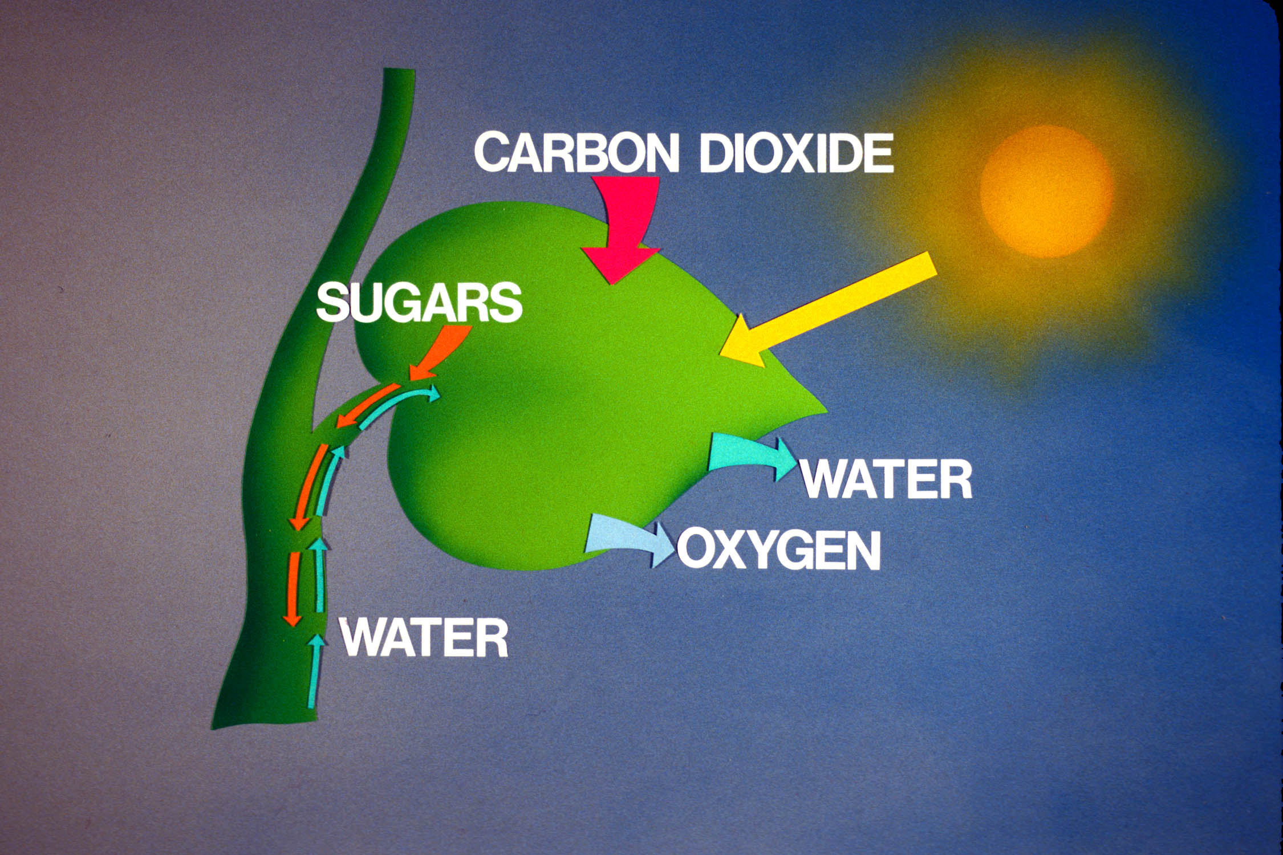
Light Energy Harvested by Plants & Other Photosynthetic Autotrophs
6 CO₂ + 6 H₂O + light energy → C₆H₁₂O₆ + 6 O₂

Slide 5
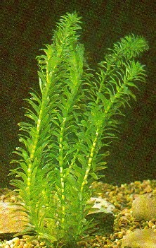
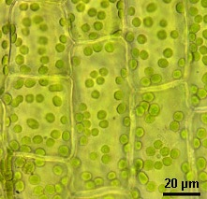
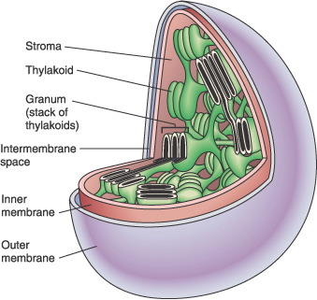
WHY ARE PLANTS GREEN?
Plant Cells have Green Chloroplasts
The thylakoid membrane of the chloroplast is impregnated with photosynthetic pigments (i.e., chlorophylls, carotenoids).

Slide 6
Photosynthesis occurs in chloroplasts
In most plants, photosynthesis occurs primarily in the leaves, in the chloroplasts
A chloroplast contains:
  stroma, a fluid
  grana, stacks of thylakoids
The thylakoids contain chlorophyll
  Chlorophyll is the green pigment that captures light for photosynthesis

Slide 7
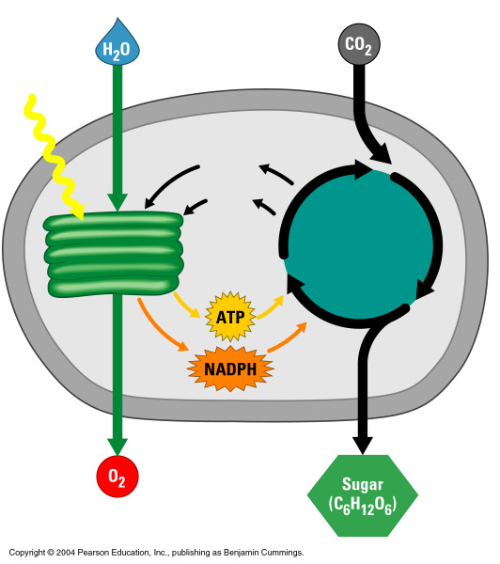
AN OVERVIEW OF PHOTOSYNTHESIS
The light reactions convert solar energy to chemical energy
  Produce ATP & NADPH
Light
Chloroplast
NADP⁺
ADP
+ P
The Calvin cycle makes sugar from carbon dioxide
  ATP generated by the light reactions provides the energy for sugar synthesis
  The NADPH produced by the light reactions provides the electrons for the reduction of carbon dioxide to glucose
Calvin
cycle
Light
reactions

Slide 8
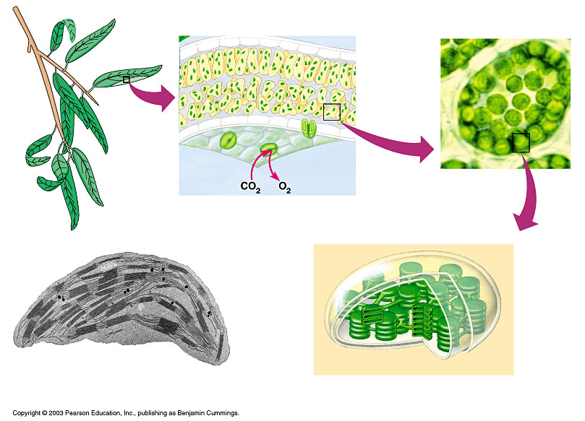
The location and structure of chloroplasts
Chloroplast
LEAF CROSS SECTION
MESOPHYLL CELL
LEAF
Mesophyll
CHLOROPLAST
Intermembrane space
Outer
membrane
Granum
Inner
membrane
Grana
Stroma
Thylakoid
compartment
Stroma
Thylakoid

Slide 9
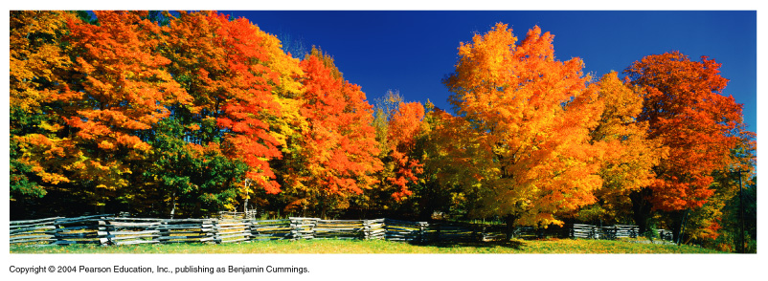
Chloroplast Pigments
Chloroplasts contain several pigments
  Chlorophyll a
  Chlorophyll b
  Carotenoids
  Xanthophyll
Figure 7.7

Slide 10
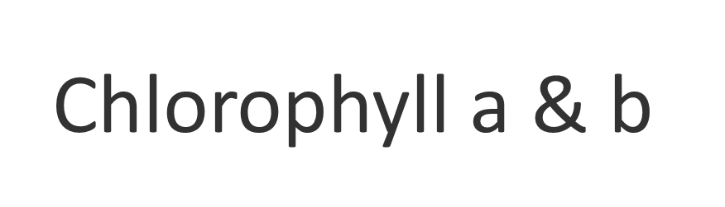
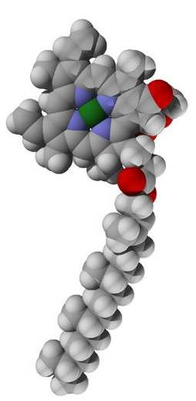
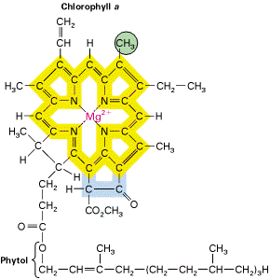
Chl a has a methyl group
Chl b has a carbonyl group
Porphyrin ring
delocalized e⁻
Phytol tail

Slide 11
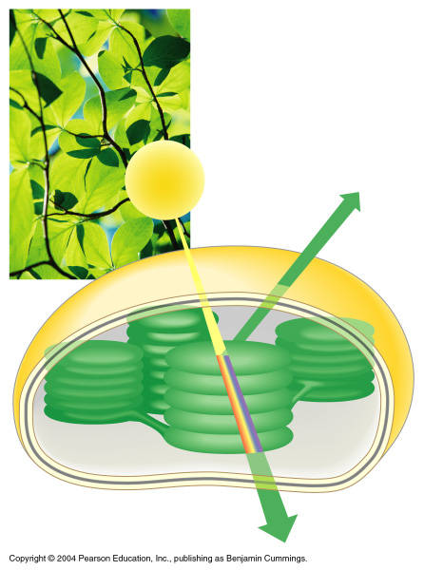
THE COLOR OF LIGHT SEEN IS THE COLOR NOT ABSORBED
Chloroplasts absorb light energy and convert it to chemical energy
Reflected
light
Light
Absorbed
light
Transmitted
light
Chloroplast

Slide 12
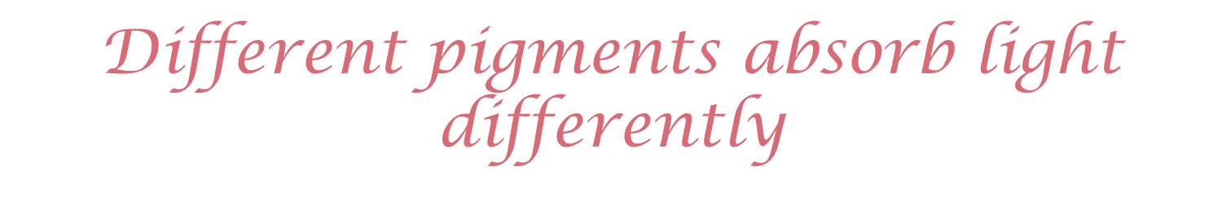
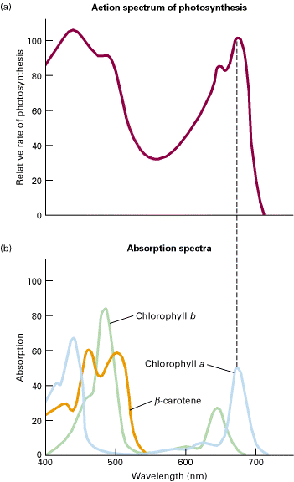
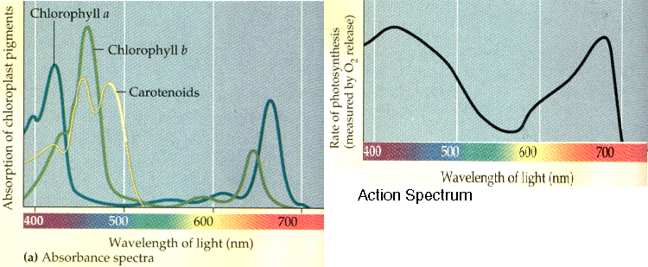

Slide 13

Two main parts (reactions).
1. Light Reaction or
Light Dependent Reaction
Produces energy from solar power (photons) in the form of ATP and NADPH.

Slide 14
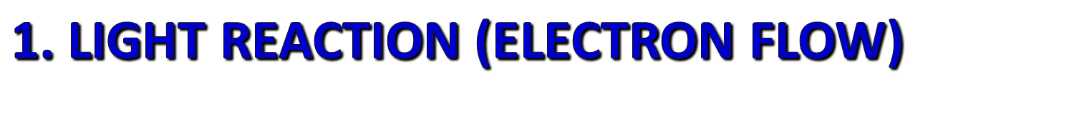
Occurs in the Thylakoid membranes
During the light reaction, there are two possible routes for electron flow.
A. Cyclic Electron Flow
B. Noncyclic Electron Flow

Slide 15
Steps of Photosynthesis
Light hits reaction centers of chlorophyll, found in chloroplasts
Chlorophyll vibrates and causes water to break apart.
Oxygen is released into air
Hydrogen remains in chloroplast attached to NADPH
“THE LIGHT REACTION”

Slide 16
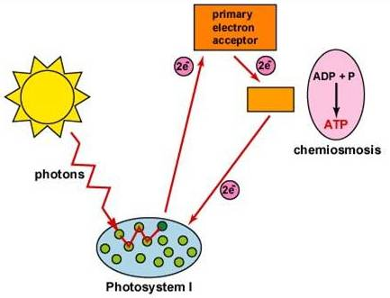
Cyclic Photophosphorylation
Process for ATP generation associated with some Photosynthetic Bacteria
Reaction Center => 700 nm

Slide 17

Occurs in the thylakoid membrane.
Uses Photosystem I only
P700 reaction center- chlorophyll a
Uses Electron Transport Chain (ETC)
Generates ATP only
ADP + ATP

Slide 18
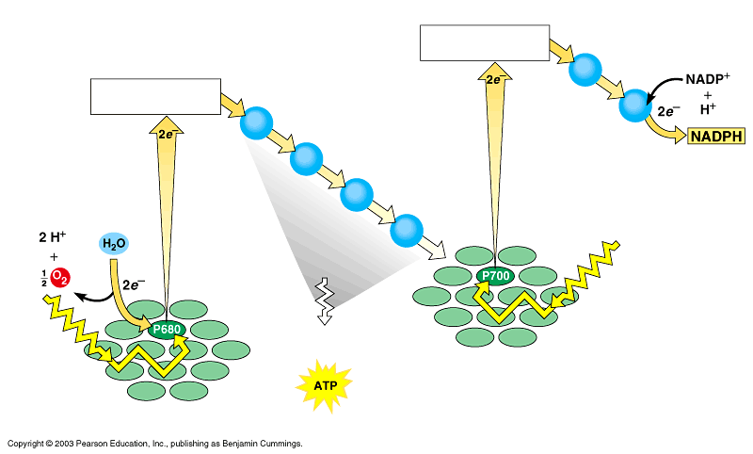
Noncyclic Photophosphorylation
Photosystem II regains electrons by splitting water, leaving O₂ gas as a by-product
Primary
electron acceptor
Electron transport
Primary
electron acceptor
Electron transport chain
Photons
Energy for
synthesis of
PHOTOSYSTEM I
PHOTOSYSTEM II
by chemiosmosis

Slide 19

Occurs in the thylakoid membrane
Uses PS II and PS I
P680 rxn center (PSII) - chlorophyll a
P700 rxn center (PS I) - chlorophyll a
Uses Electron Transport Chain (ETC)
Generates O₂, ATP and NADPH

Slide 20

ADP + → ATP
NADP⁺ + H → NADPH
Oxygen comes from the splitting of H₂O, not CO₂
H₂O → 1/2 O₂ + 2H⁺
(Oxidized)

Slide 21
In the light reactions, electron transport chains generate ATP, NADPH, & O₂
Two connected photosystems collect photons of light and transfer the energy to chlorophyll electrons
The excited electrons are passed from the primary electron acceptor to electron transport chains
  Their energy ends up in ATP and NADPH

Slide 22
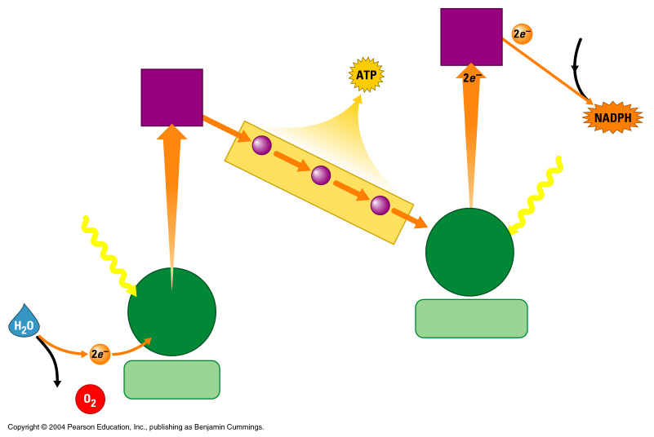
How the Light Reactions Generate ATP and NADPH
Primary
electron
acceptor
NADP⁺
Energy
to make
Primary
electron
acceptor
3
2
Light
Electron transport chain
Light
Primary
electron
acceptor
Reaction-
center
chlorophyll
NADPH-producing
photosystem
1
Water-splitting
photosystem
2 H⁺ + ¹/₂

Slide 23
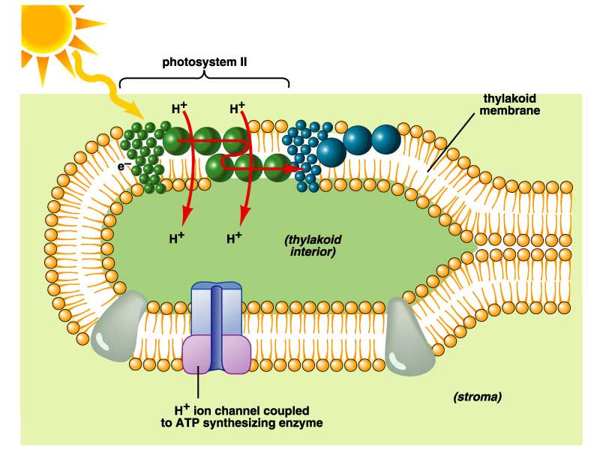

Slide 24
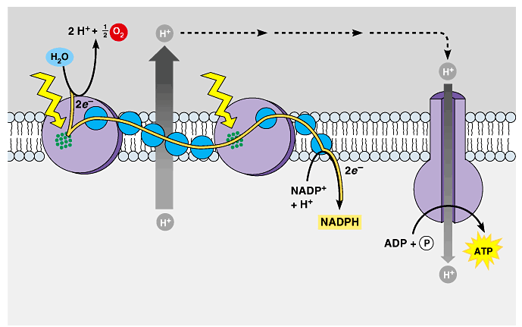
The production of ATP by chemiosmosis in photosynthesis
Thylakoid
compartment
(high H⁺)
Light
Light
Thylakoid
membrane
Antenna
molecules
Stroma
(low H⁺)
ELECTRON TRANSPORT
CHAIN
PHOTOSYSTEM II
PHOTOSYSTEM I
ATP SYNTHASE

Slide 25
Summary—Light Dependent Reactions
a. Overall input
light energy, H₂O.
b. Overall output
ATP, NADPH, O₂.

Slide 26
Steps of Photosynthesis
The DARK Reactions= Calvin Cycle
CO2 from atmosphere is joined to H from water molecules (NADPH) to form glucose
Glucose can be converted into other molecules with yummy flavors!

Slide 27
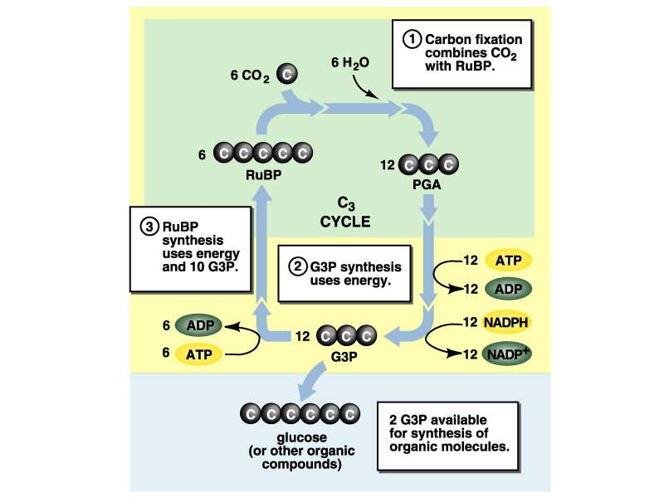

Slide 28
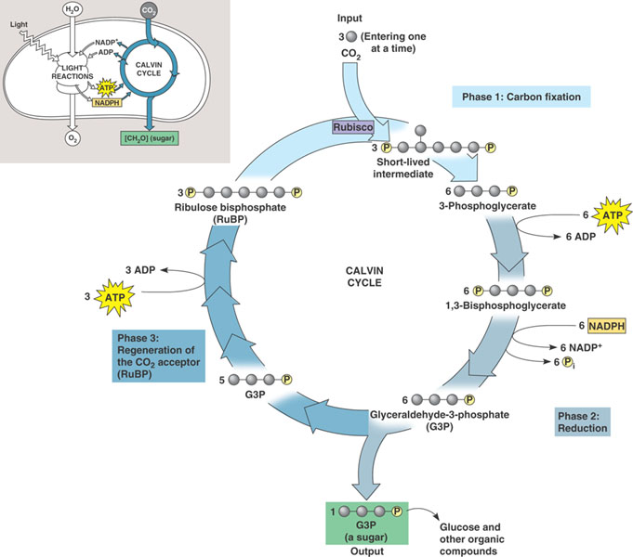
Light Independent Reactions aka Calvin Cycle
Carbon from CO2 is
converted to glucose
(ATP and NADPH
drive the reduction
of CO2 to C6H12O6.)

Slide 29

2. Calvin Cycle or
Light Independent Reaction or
Carbon Fixation or
C₃ Fixation
Uses energy (ATP and NADPH) from light rxn to make sugar (glucose).

Slide 30
Primary
Electron
Acceptor
2e⁻
Enzyme
Reaction
Primary
Electron
Acceptor
2e⁻
2e⁻
ETC
SUN
2e⁻
2e⁻
NADPH
P700
Photon
ATP
P680
Photon
H₂O
1/2O₂ + 2H⁺
Photosystem I
Photosystem II

Slide 31
Light Independent Reactions aka Calvin Cycle
CO2 is added to the 5-C sugar RuBP by the enzyme rubisco.
This unstable 6-C compound splits to two molecules of PGA or 3-phosphoglyceric acid.
PGA is converted to Glyceraldehyde 3-phosphate (G3P), two of which bond to form glucose.
G3P is the 3-C sugar formed by three turns of the cycle.

Slide 32

(36C)
(6C)
6C-C-C-C-C-C
6CO₂
(unstable)
6C-C-C
6C-C-C
12PGA
(36C)
6ATP
6ATP
(30C)
6C-C-C-C-C
6NADPH
6NADPH
RuBP
(36C)
6ATP
6C-C-C
6C-C-C
12G₃P
(30C)
(6C)
C₃
C-C-C-C-C-C
glucose
Glucose

Slide 33
Summary—Light Independent Reactions
a. Overall input
CO₂, ATP, NADPH.
b. Overall output
glucose.

Slide 34
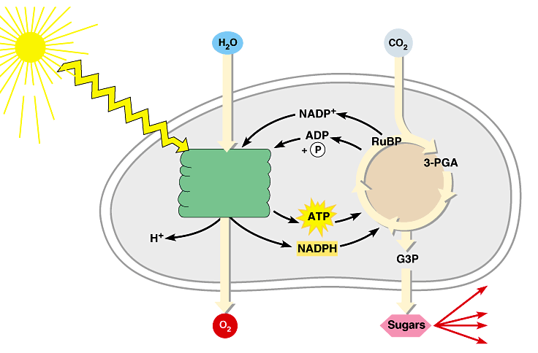
Review: Photosynthesis uses light energy to make food molecules
A summary of the chemical processes of photosynthesis
Chloroplast
Light
Photosystem II
Electron transport chains Photosystem I
CALVIN CYCLE
Stroma
Electrons
Cellular respiration
Cellulose
Starch
LIGHT REACTIONS
CALVIN CYCLE
Other organic compounds

Slide 35
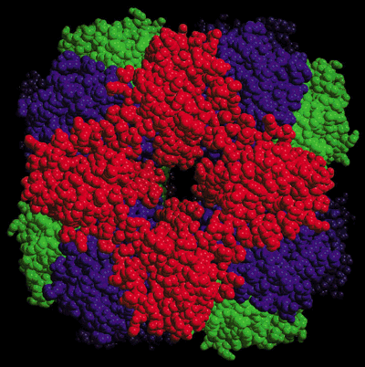
Types of Photosynthesis
C3
C4
CAM
Rubisco: the world’s busiest enzyme!

Slide 36
Photorespiration
When Rubisco reacts with O₂ instead of CO₂
Occurs under the following conditions:
  Intense Light (high O₂ concentrations)
  High heat
Photorespiration is estimated to reduce photosynthetic efficiency by 25%

Slide 37
Why high heat?
When it is hot, plants close their stomata to conserve water
They continue to do photosynthesis → use up CO₂ and produce O₂ → creates high O₂ concentrations inside the plant → photorespiration occurs

Slide 38
C4 Photosynthesis
Certain plants have developed ways to limit the amount of photorespiration
  C4 Pathway*
  CAM Pathway*
  * Both convert CO₂ into a 4 carbon intermediate → C4 Photosynthesis

Slide 39
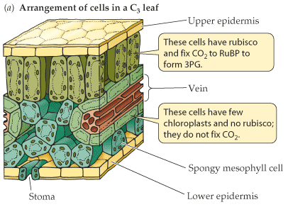
Leaf Anatomy
In C3 plants (those that do C3 photosynthesis), all processes occur in the mesophyll cells.
Mesophyll cells
Bundle sheath cells

Slide 40
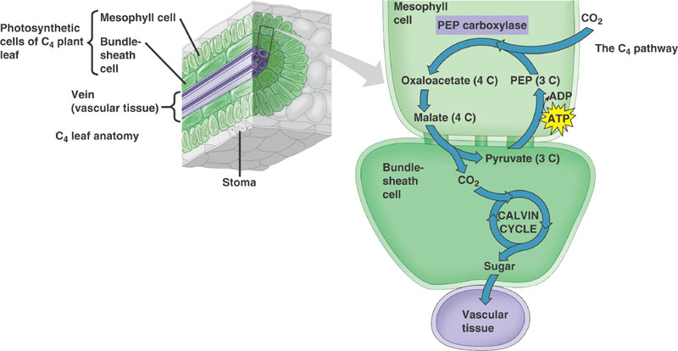
C4 Pathway
In C4 plants photosynthesis occurs in both the mesophyll and the bundle sheath cells.
Notes:
Affinity of PEP Carboxylase for CO2 is much higher than its affinity for O2.

Slide 41
C4 Pathway
CO₂ is fixed into a 4-carbon intermediate
Has an extra enzyme– PEP Carboxylase that initially traps CO₂ instead of Rubisco– makes a 4 carbon intermediate

Slide 42
C4 Pathway
The 4 carbon intermediate is “smuggled” into the bundle sheath cell
The bundle sheath cell is not very permeable to CO₂
CO₂ is released from the 4C malate → goes through the Calvin Cycle
C3 Pathway

Slide 43
How does the C4 Pathway limit photorespiration?
Bundle sheath cells are far from the surface– less O₂ access
PEP Carboxylase doesn’t have an affinity for O₂ → allows plant to collect a lot of CO₂ and concentrate it in the bundle sheath cells (where Rubisco is)

Slide 44
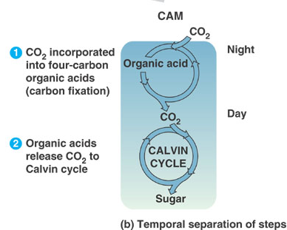
CAM Pathway
Fix CO₂ at night and store as a 4 carbon molecule
Keep stomates closed during day to prevent water loss
Same general process as C4 Pathway

Slide 45
How does the CAM Pathway limit photorespiration?
Collects CO₂ at night so that it can be more concentrated during the day
Plant can still do the calvin cycle during the day without losing water

Slide 46



